Slide 1
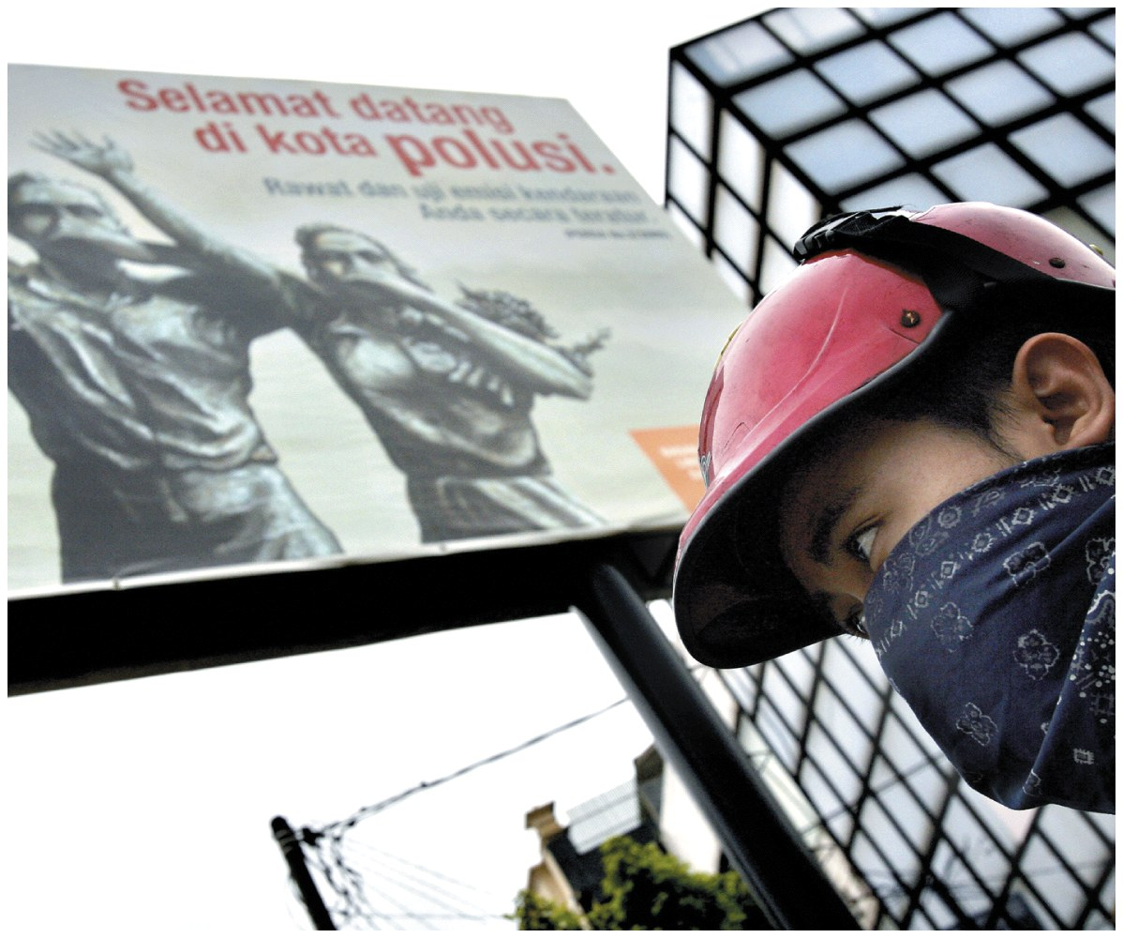
Air Pollution

Slide 2
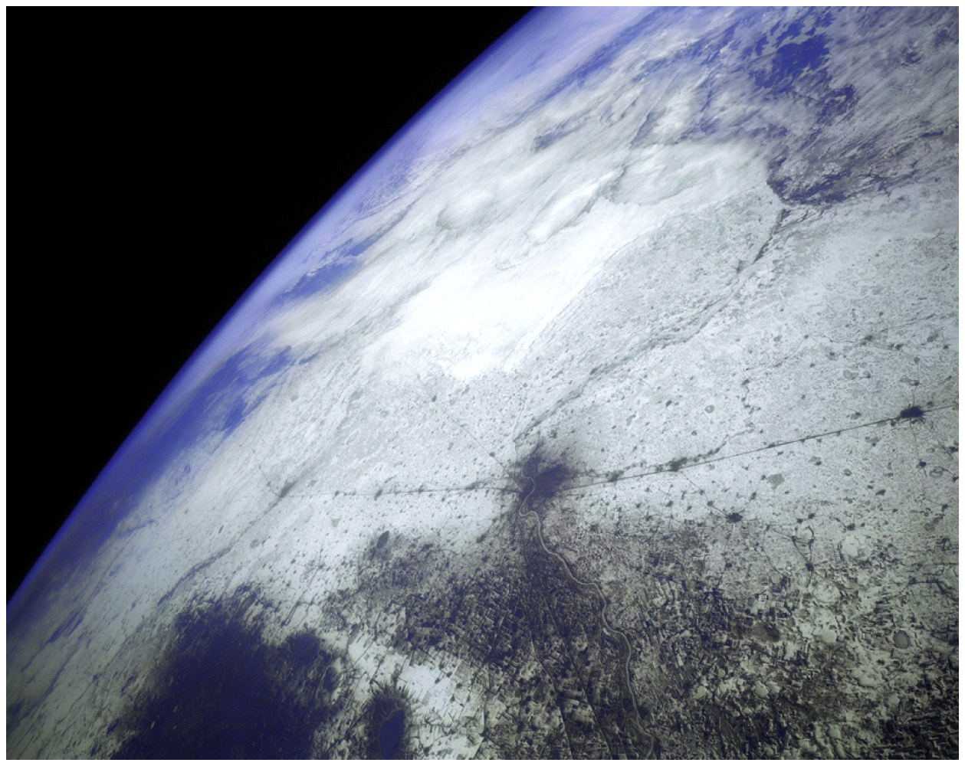
Atmosphere as a Resource
Atmospheric Composition
Nitrogen 78.08%
Oxygen 20.95%
Argon 0.93%
Carbon dioxide 0.04%
Ecosystem services
Blocks UV radiation
Moderates the climate
Redistributes water in the hydrologic cycle

Slide 3
Types and Sources of Air Pollution
Air Pollution
Chemicals added to the atmosphere by natural events or human activities in high enough concentrations to be harmful
Two categories
Primary Air Pollutant
Harmful substance that is emitted directly into the atmosphere
Secondary Air Pollutant
Harmful substance formed in the atmosphere when a primary air pollutant reacts with substances normally found in the atmosphere or with other air pollutants

Slide 4
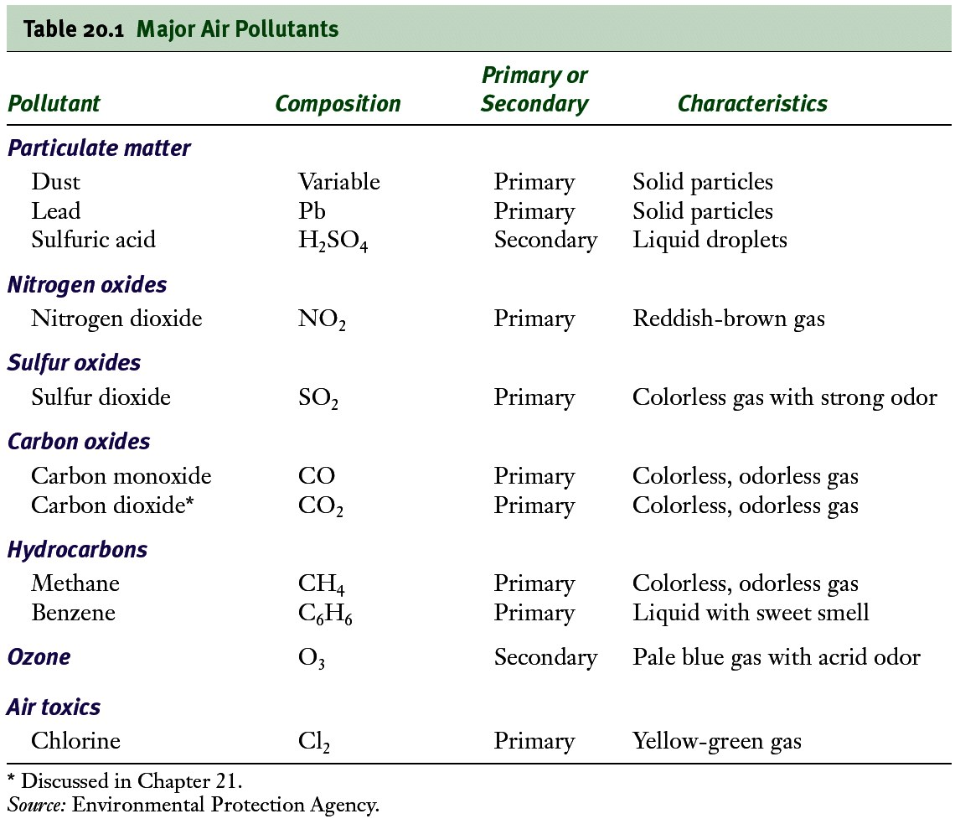
Major Air Pollutants

Slide 5
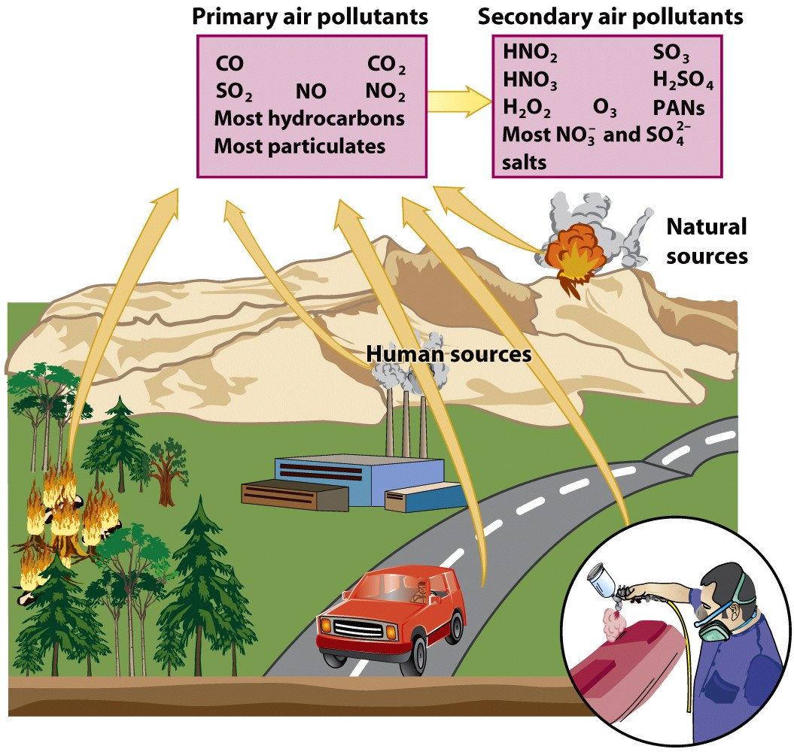

Slide 6
Major Classes of Air Pollutants
Particulate Material
Nitrogen Oxides
Sulfur Oxides
Carbon Oxides
Hydrocarbons
Ozone

Slide 7
Particulate Material
Thousands of different solid or liquid particles suspended in air
Includes: soil particles, soot, lead, asbestos, sea salt, and sulfuric acid droplets
Dangerous for 2 reasons
May contain materials with toxic or carcinogenic effects
Extremely small particles can become lodged in lungs

Slide 8
Nitrogen and Sulfur Oxides
Nitrogen Oxides
Gases produced by the chemical interactions between atmospheric nitrogen and oxygen at high temperature
Problems
Greenhouse gases
Cause difficulty breathing
Sulfur Oxides
Gases produced by the chemical interactions between sulfur and oxygen
Causes acid precipitation

Slide 9
Carbon Oxides and Hydrocarbons
Carbon Oxides
Gases carbon monoxide (CO) and carbon dioxide (CO₂)
Greenhouse gases
Hydrocarbons
Diverse group of organic compounds that contain only hydrogen and carbon (ex: CH₄- methane)
Some are related to photochemical smog and greenhouse gases

Slide 10
Ozone
Tropospheric Ozone
Man- made pollutant in the lower atmosphere
Secondary air pollutant
Component of photochemical smog
Stratospheric Ozone
Essential component that screens out UV radiation in the upper atmosphere
Man- made pollutants (ex: CFCs) can destroy it

Slide 11
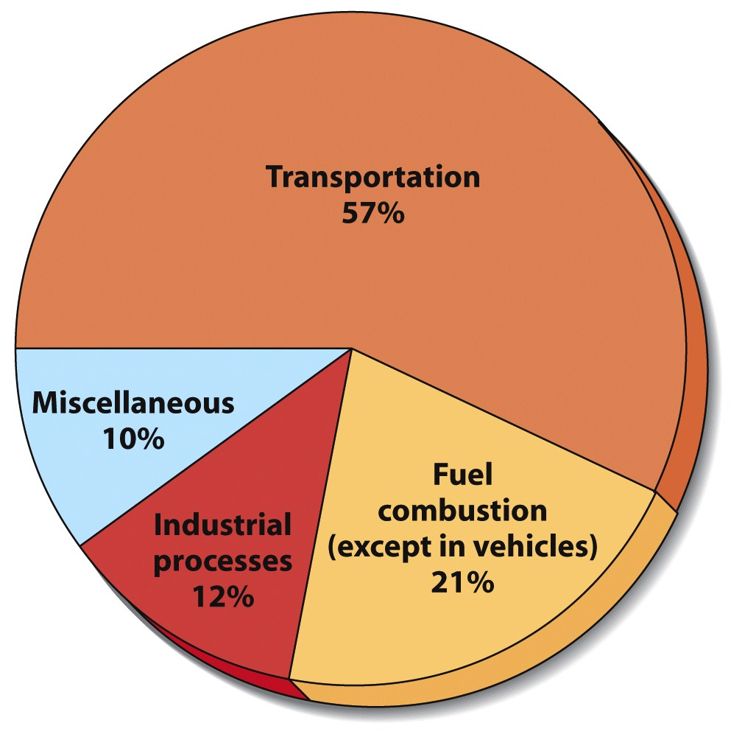
Sources of Outdoor Air Pollution
Two main sources
Transportation
Industry
Intentional forest fires is also high

Slide 12
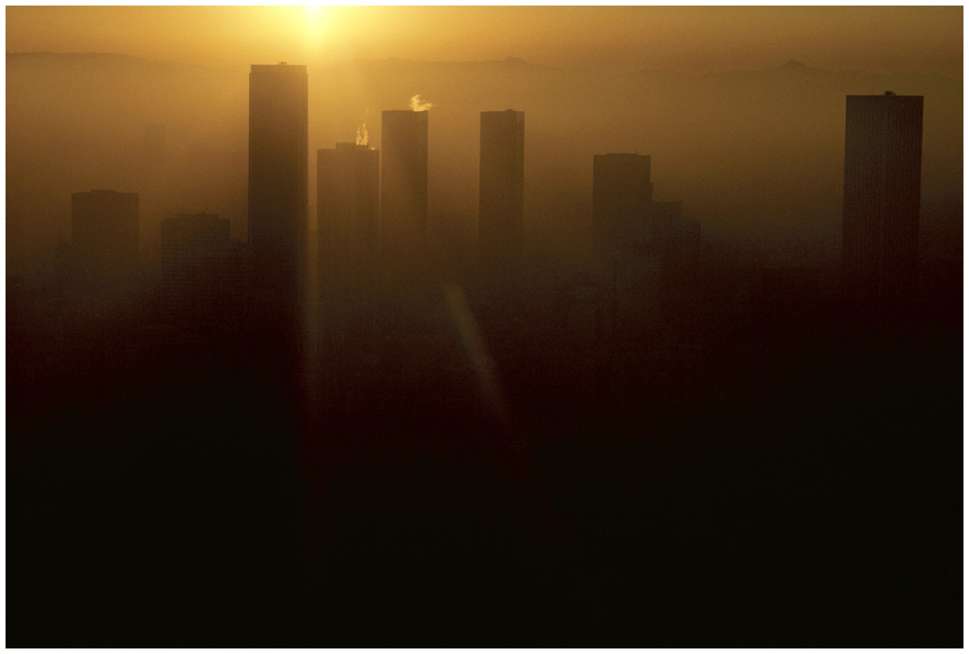
Urban Air Pollution
Photochemical Smog (ex: Los Angeles below)
Brownish-orange haze formed by chemical reactions involving sunlight, nitrogen oxide, and hydrocarbons

Slide 13
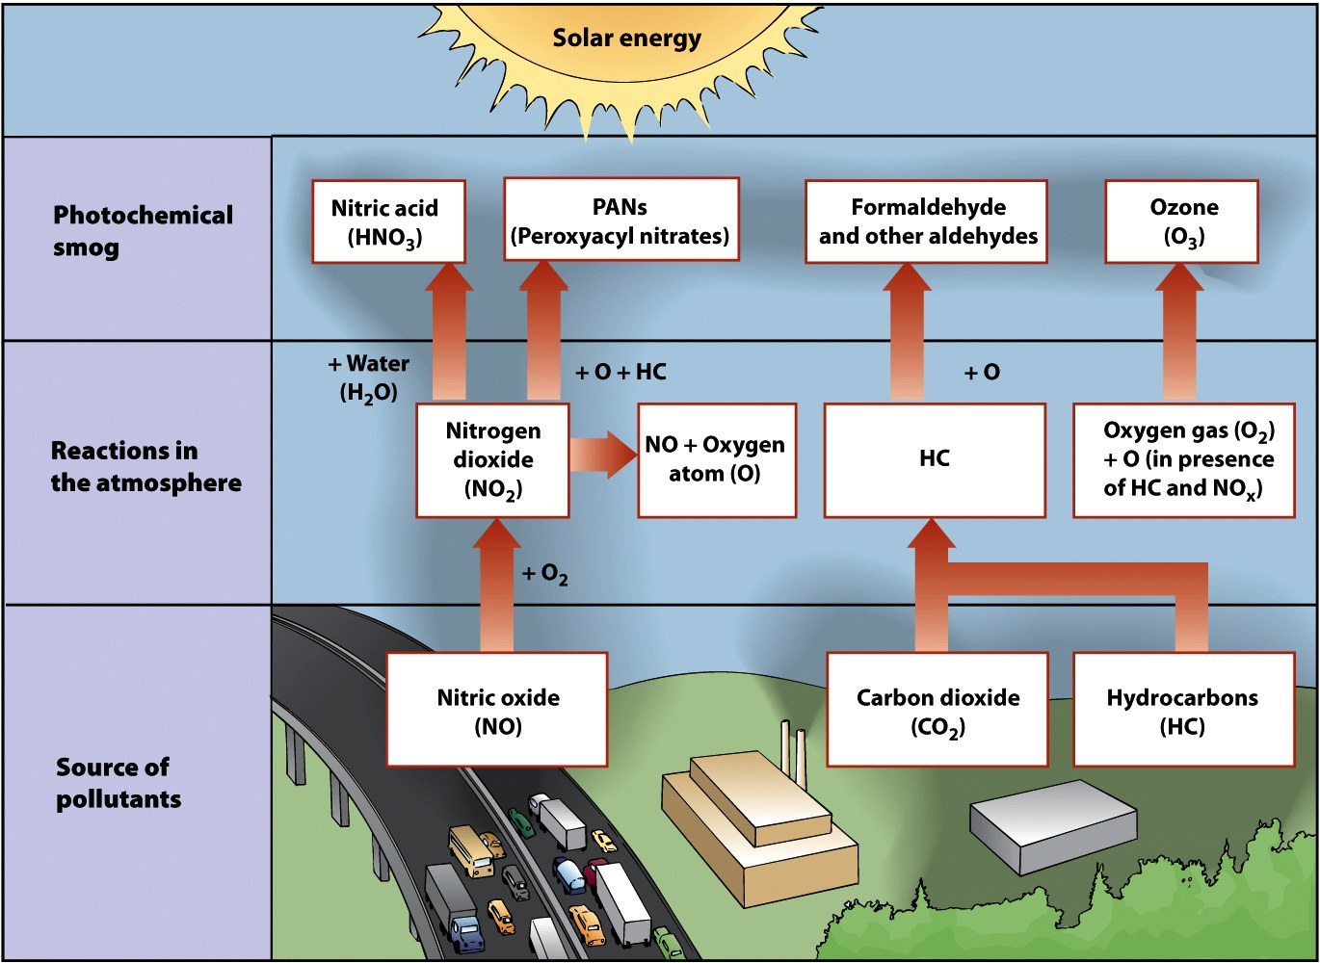
Formation of Photochemical Smog

Slide 14
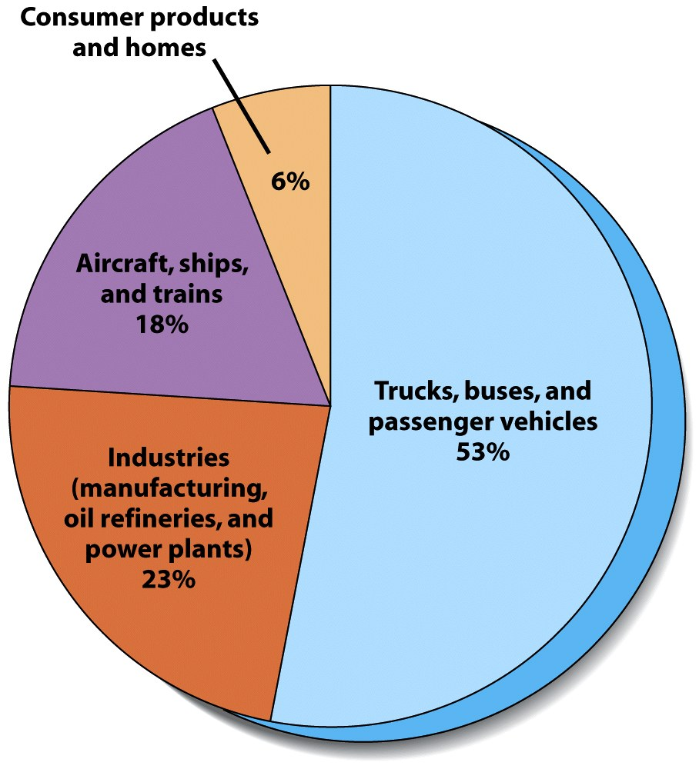
Sources of Smog in Los Angeles

Slide 15
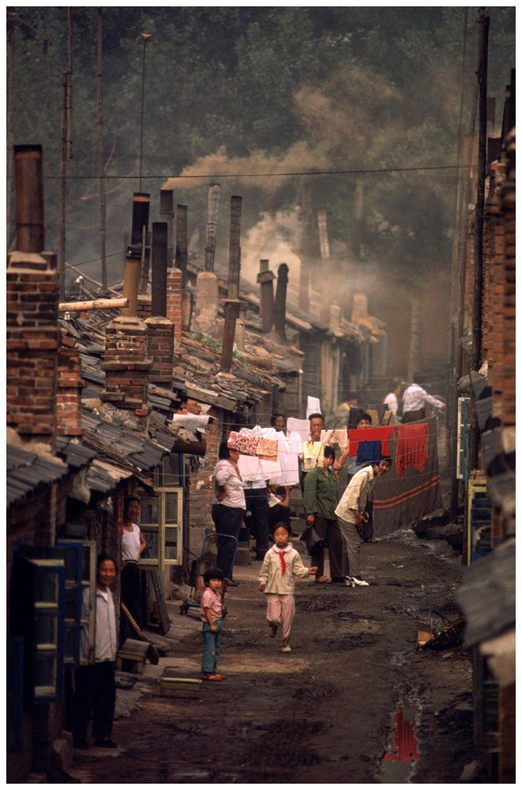
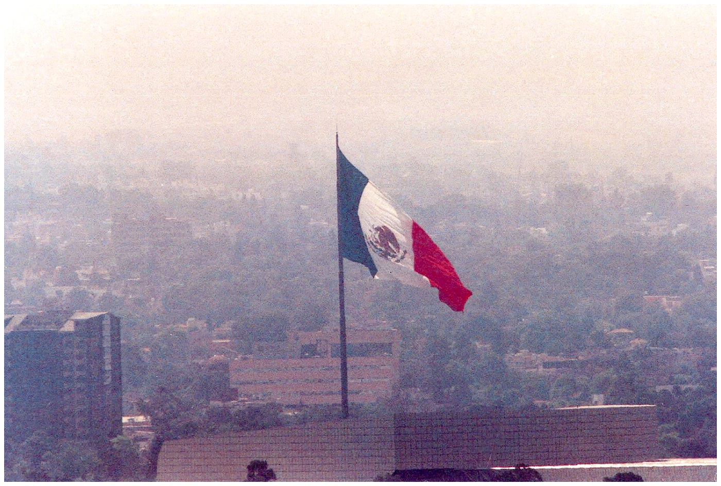
Case-In-Point Air Pollution in Beijing and Mexico City
Beijing (left)
Mexico City (above)

Slide 16
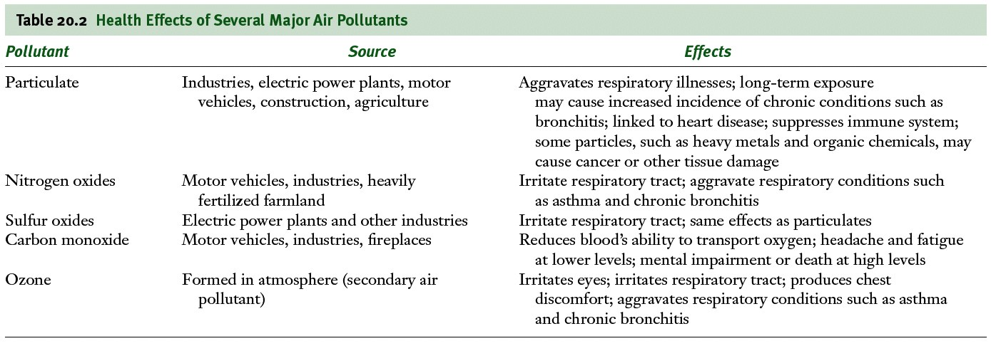
Effects of Air Pollution
Low level exposure
Irritates eyes
Causes inflammation of respiratory tract
Can develop into chronic respiratory diseases

Slide 17
Health Effects of Air Pollution
Sulfur Dioxide and Particulate material
Irritate respiratory tract and impair ability of lungs to exchange gases
Nitrogen Dioxides
Causes airway restriction
Carbon monoxide
Binds with iron in blood hemoglobin
Causes headache, fatigue, drowsiness, death
Ozone
Causes burning eyes, coughing, and chest discomfort

Slide 18
Children and Air Pollution
Greater health threat to children than adults
Air pollution can restrict lung development
Children breath more often than adults
Children who live in high ozone areas are more likely to develop asthma

Slide 19
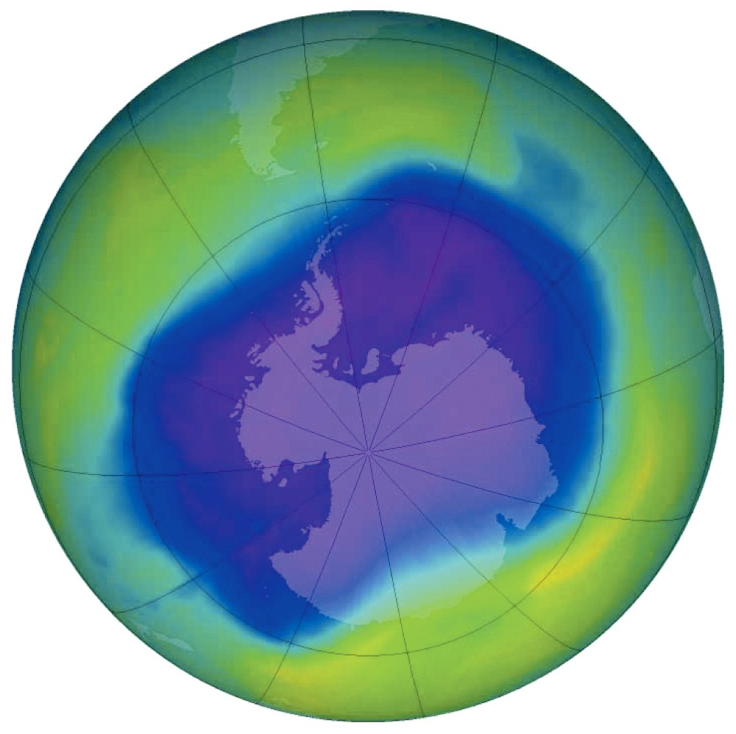
Ozone Depletion in Stratosphere
Ozone thinning/hole
First identified in 1985 over Antarctica
Caused by
human-produced bromine and chlorine containing chemicals
Ex: CFCs

Slide 20
Ozone Depletion in Stratosphere
Hole over Antarctica requires two conditions:
Sunlight just returning to polar region
Circumpolar vortex- a mass of cold air that circulates around the southern polar region
Isolates it from the warmer air in the rest of the planet
Polar stratospheric clouds form
Enables Cl and Br to destroy ozone

Slide 21
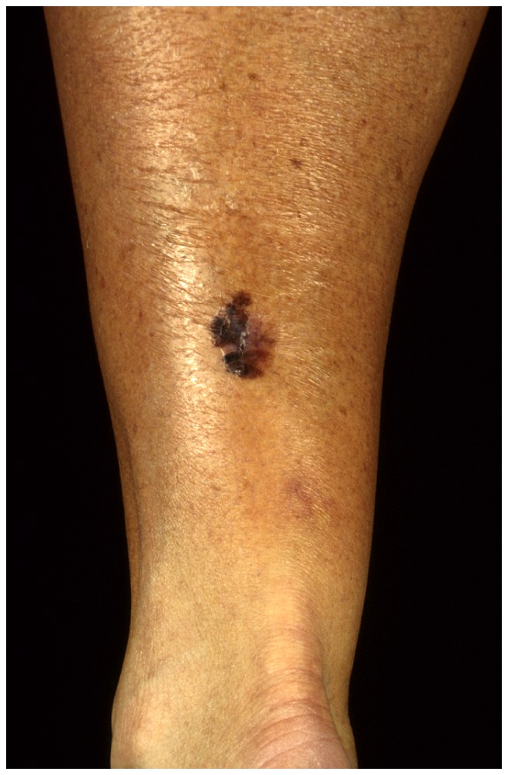
Effects of Ozone Depletion
Higher levels of UV-radiation hitting the earth
Eye cataracts
Skin cancer (right)
Weakened immunity
May disrupt ecosystems
May damage crops and forests

Slide 22
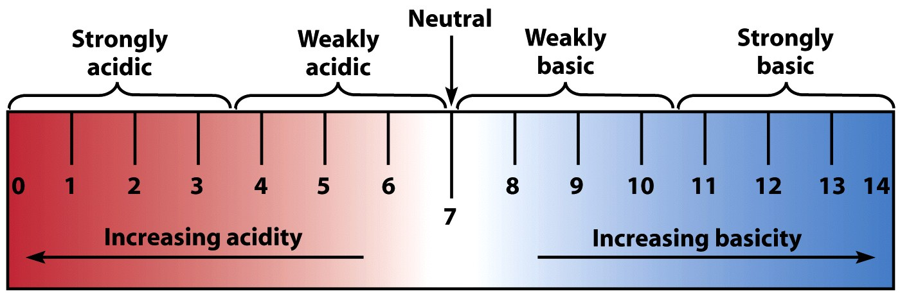
Acid Deposition
Sulfur dioxide and nitrogen dioxide emissions react with water vapor in the atmosphere and form acids that return to the surface as either dry or wet deposition
pH scale

Slide 23
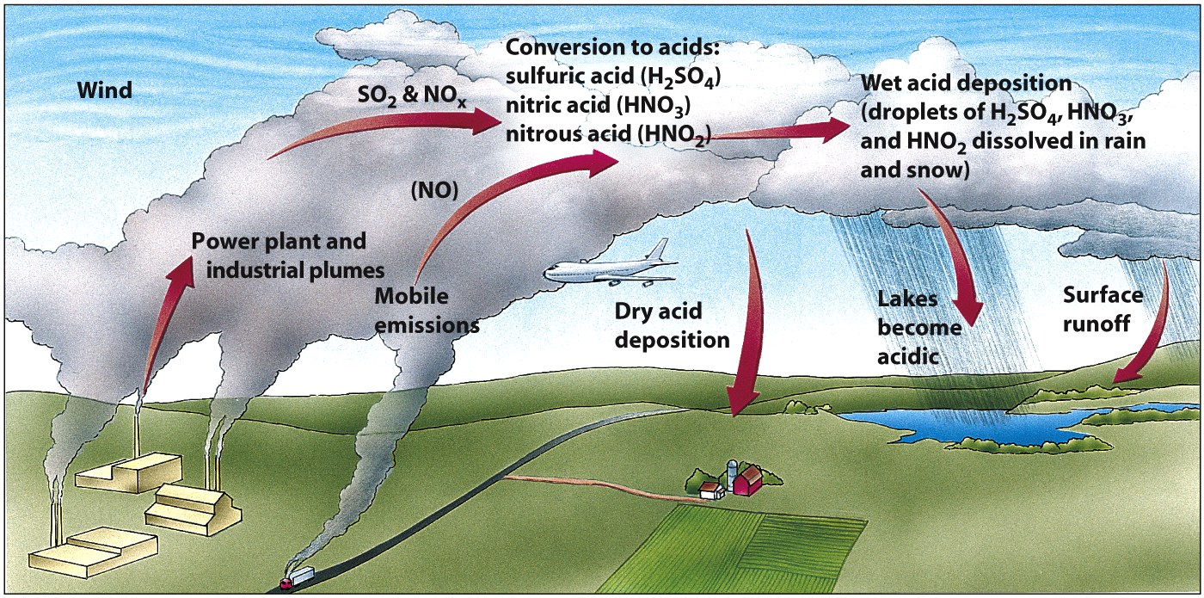
How Acid Deposition Develops

Slide 24
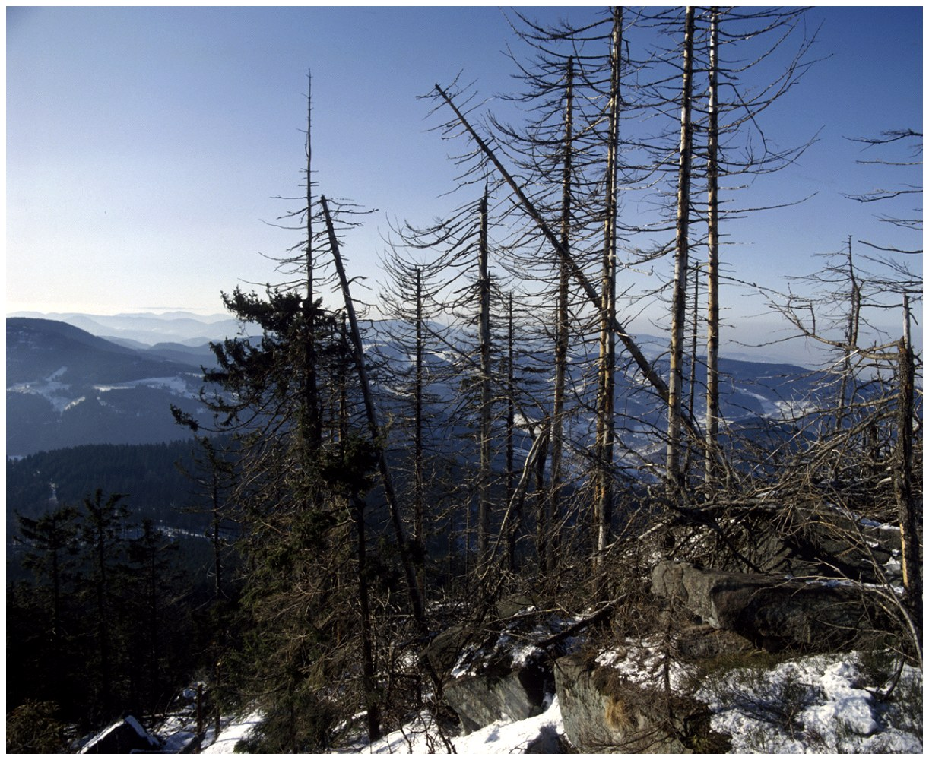
Effects of Acid Deposition
Declining Aquatic Animal Populations
Thin-shelled eggs prevent bird reproduction
Because calcium is unavailable in acidic soil
Forest decline
Ex: Black forest in Germany (50% is destroyed)

Slide 25
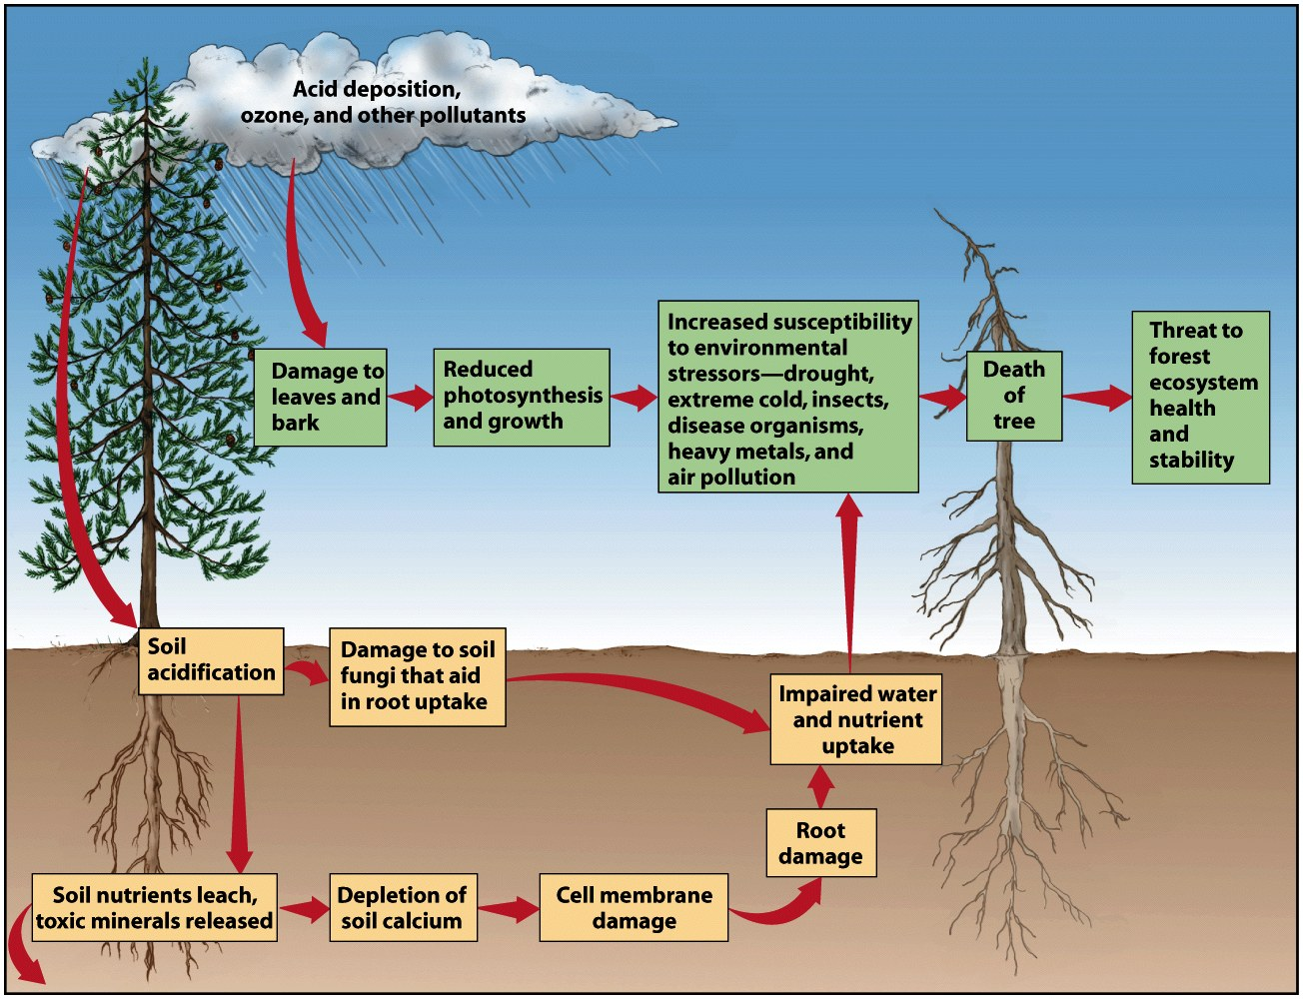
Acid Deposition and Forest Decline

Slide 26
Air Pollution Around the World
Air quality is deteriorating rapidly in developing countries
Shenyang, China
Residents only see sunlight a few weeks each year
Developing countries have older cars
Still use leaded gasoline
5 worst cities in world
Beijing, China; Mexico City, Mexico; Shanghai, China; Tehran, Iran; and Calcutta, India

Slide 27
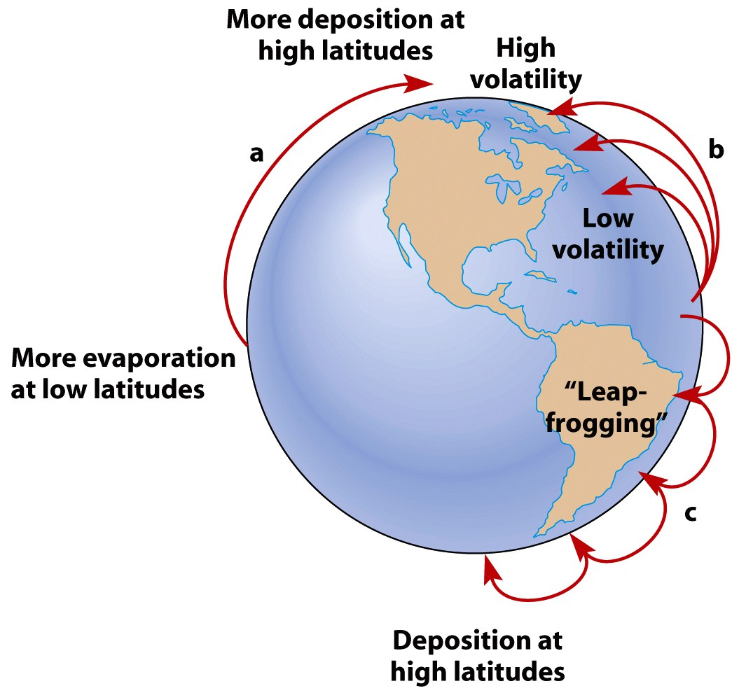
Long Distance Transport of Air Pollutants

Slide 28
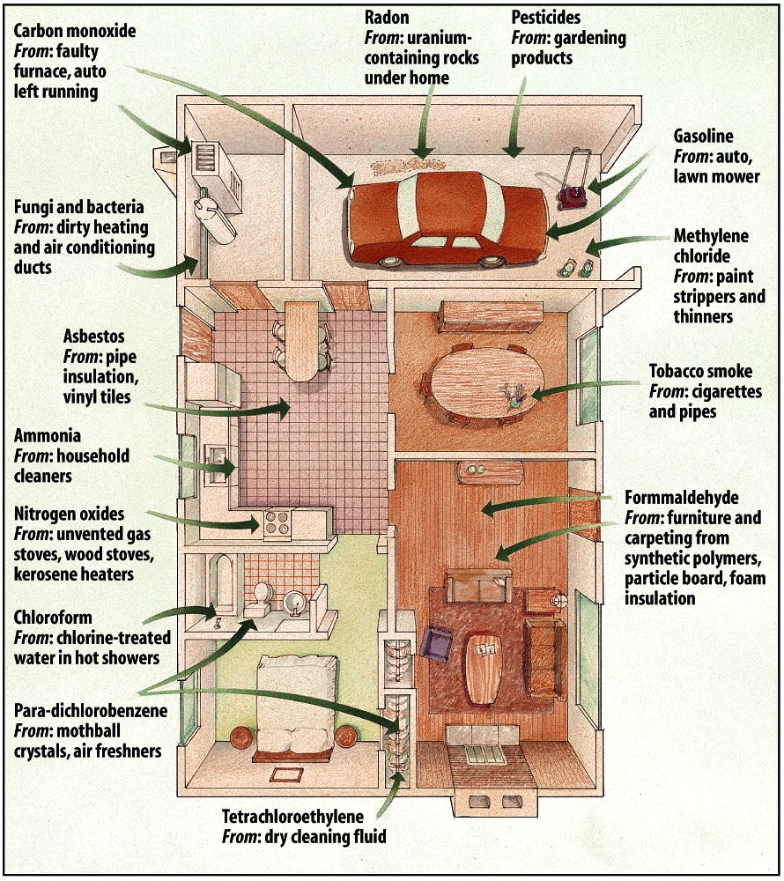
Indoor Air Pollution
Pollutants can be 5-100X greater than outdoors
Most common:
Radon, cigarette smoke, carbon monoxide, nitrogen dioxide, formaldehyde pesticides, lead, cleaning solvents, ozone, and asbestos

Slide 29
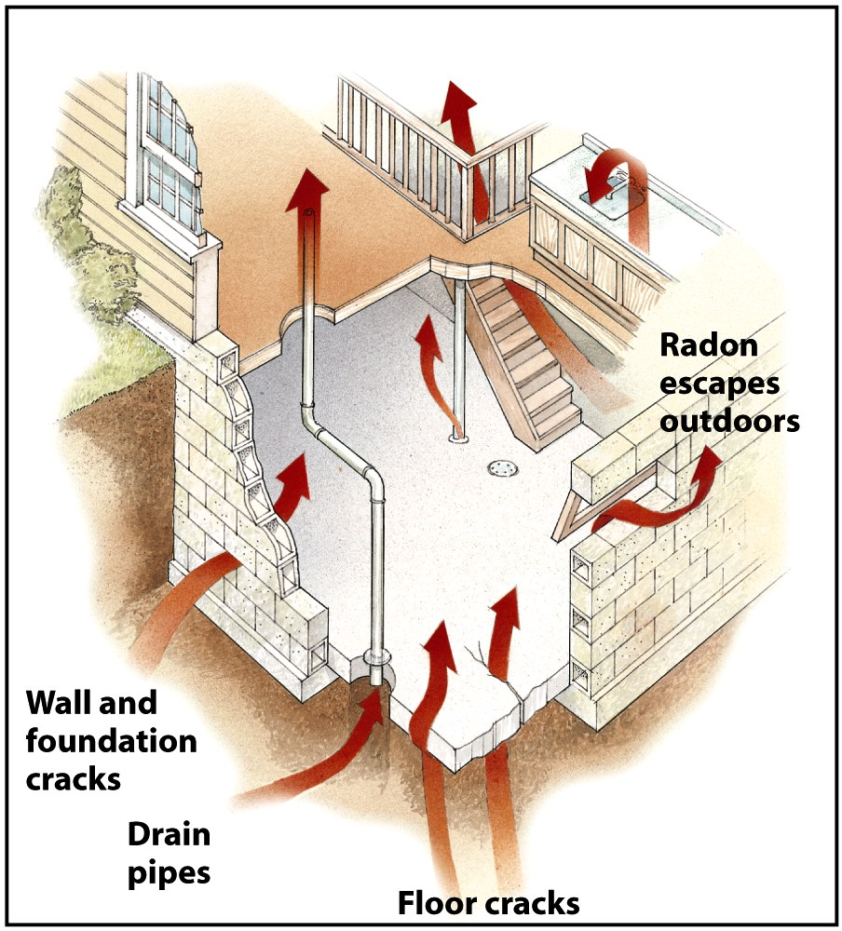
Indoor Air Pollution - Radon

